Slide 1


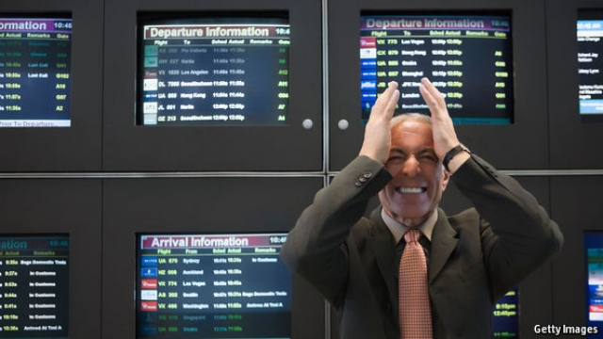
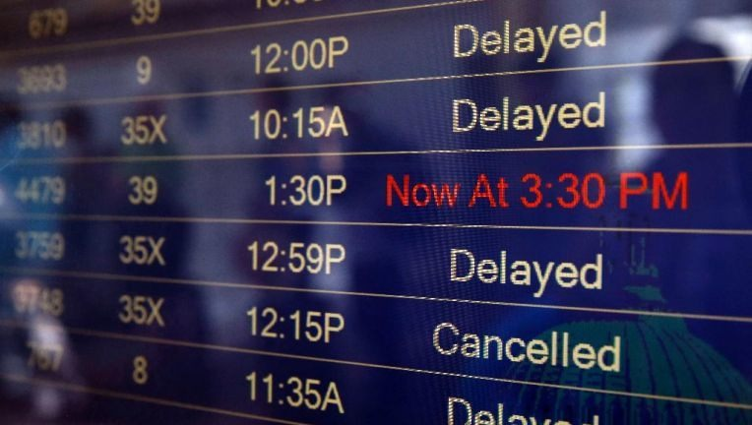

Airline On-Time Statistics and Delay Causes
AVIMA - Statistics
Prof. Dr. Rainer Stollhoff
01 February 2019
- By Team Lavanya, Van, Jim and Bolaji.

Slide 2
Project Pitch for Airline On-Time Statistics and Delay Causes
Table of Contents
Introduction
Data source
Results
Explanation
Project plan
Sources

Slide 3
Airline On-Time Statistics and Delay Causes
Introduction and Data source
  Aviation is being the most dynamic business sectors in the world, Flight delays affect passenger travel satisfaction and increase in airline costs. From the United States Department of Transportation aviation data we have analysed the causes of delay in three airports from 2004 to 2018 using descriptive analysis.
  Main factors affecting on-time performance of airlines are Weather, National Aviation System issues (NAS), Security issues, Carrier issues, Aircraft Arrival etc…
  Apart from our individual interests, we share a dream of being in aviation field from
  our childhood, how the airliners and the airport is working along to attain the
  on-time performance and causes for delays.
  To understand the Business Intellegence of an airliner, On-time performance and delay causes directly impact on cost components and cost factors such as Fuel, Maintenance, Crew, Aircraft depreciation, rental, lease, Airport charges, Ground and Passenger handling, Aircraft Operator passenger cost and many others.

Slide 4
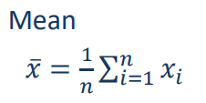
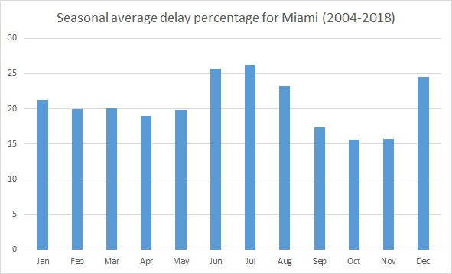
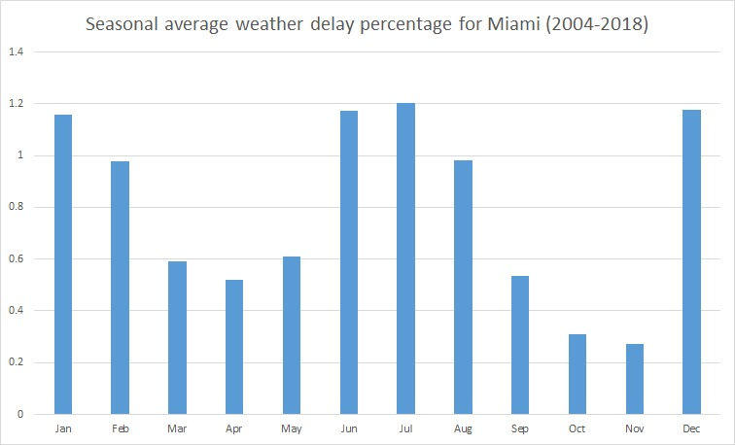
Airline On-Time Statistics and Delay Causes
  Results from Miami international airport - VAN

Slide 5
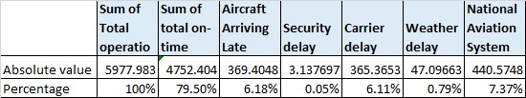
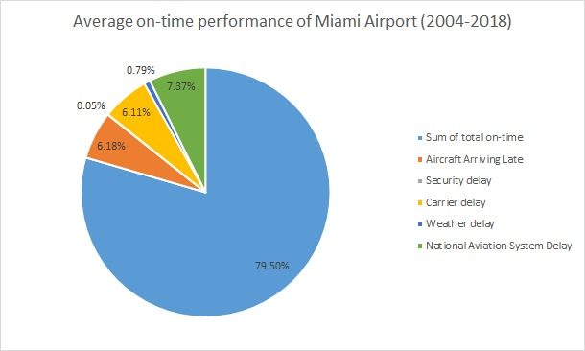
Airline On-Time Statistics and Delay Causes

Slide 6
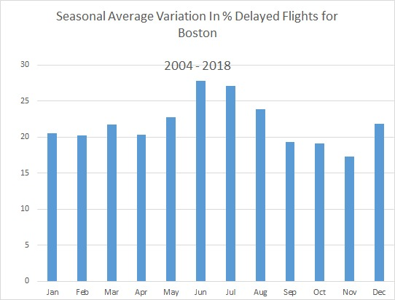
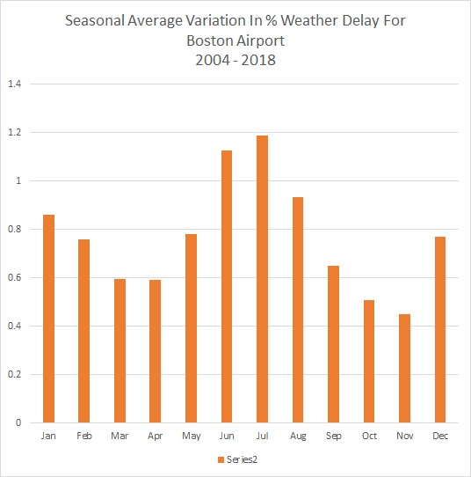
Airline On-Time Statistics and Delay Causes
  Results from Boston Logan International airport - JIM

Slide 7
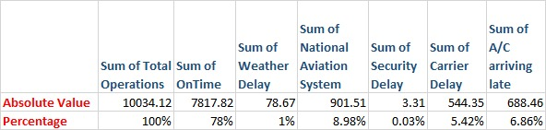
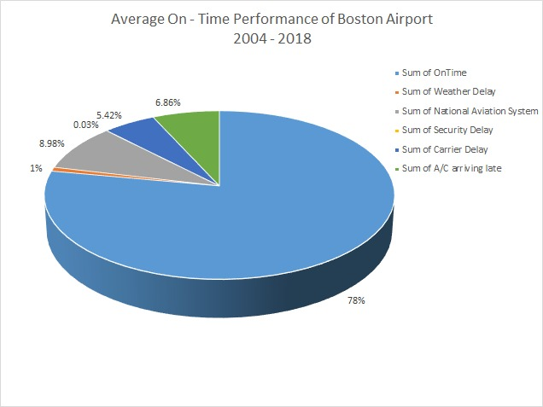
Airline On-Time Statistics and Delay Causes

Slide 8
Airline On-Time Statistics and Delay Causes
  Results from Denver International airport - Lavanya

Slide 9
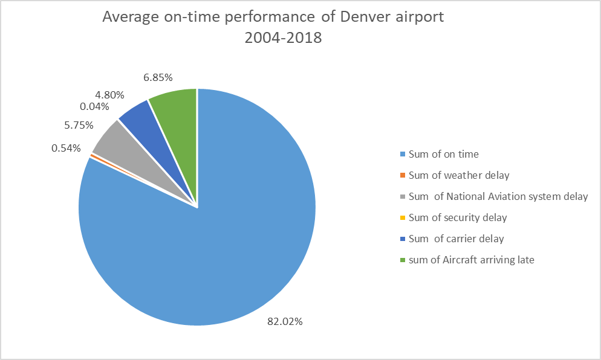
Airline On-Time Statistics and Delay Causes

Slide 10
Airline On-Time Statistics and Delay Causes
Observations:
From the results percentage of delay from weather of all the three airports are lower than 3%
Question – Is the weather delay category includes all the weather related causes?

Slide 11
Airline On-Time Statistics and Delay Causes
Categories definition
Air Carrier: The cause of the cancellation or delay was due to circumstances within the airline's control (e.g. maintenance or crew problems, aircraft cleaning, baggage loading, fueling, etc.).
Weather: Significant weather conditions that, delays or prevents the operation of a flight such as tornado, blizzard or hurricane.
National Aviation System (NAS): Delays and cancellations refer to a broad set of conditions, such as non-extreme weather conditions, airport operations, heavy traffic volume, and air traffic control.
Late-arriving aircraft: A previous flight with same aircraft arrived late, causing the present flight to depart late.
Security: Delays or cancellations caused by evacuation, re-boarding, inoperative screening equipment…

Slide 12
Airline On-Time Statistics and Delay Causes
Answer:
The weather category consists of extreme weather that prevents flying.
There is another category of weather within the NAS category, which slows the operations of the system but does not prevent flying.
Another attribution come from the weather-related delays included in the "late-arriving aircraft" category. Airlines do not report the causes of the late-arriving aircraft but it also possible that the flight arrive late because of the bad weather with in the route.

Slide 13
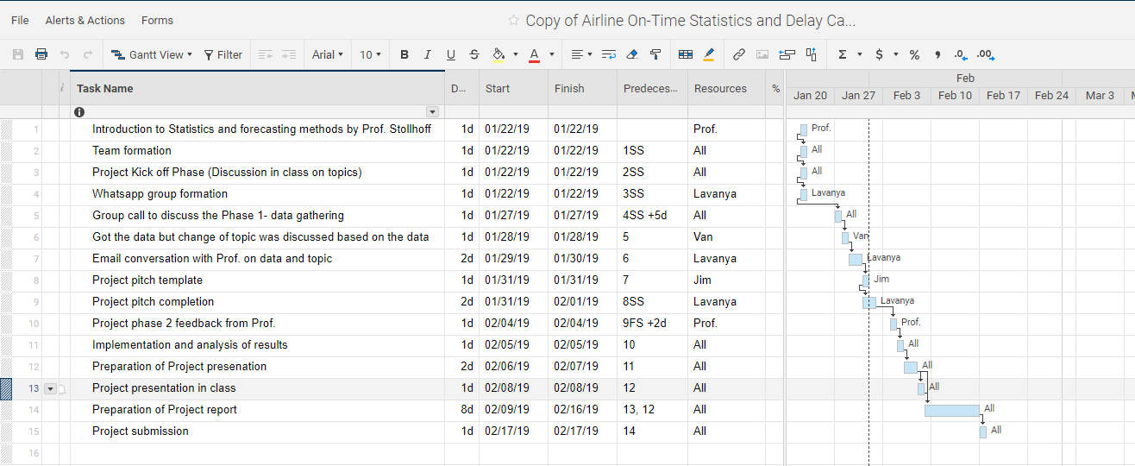
Airline On-Time Statistics and Delay Causes
  Project plan (Smart sheet):

Slide 14

Airline On-Time Statistics and Delay Causes

Slide 15
Airline On-Time Statistics and Delay Causes
Sources:
https://www.nytimes.com/2012/01/28/business/ny-airports-account-for-half-of-all-delays.html
https://www.researchgate.net/publication
https://www.transtats.bts.gov/OT_Delay/OT_DelayCause1.asp
https://help.smartsheet.com
https://www.transtats.bts.gov/OT_Delay/OT_DelayCause1.asp?pn=1
https://www.bts.gov/topics/airlines-and-airports/understanding-reporting-causes-flight-delays-and-cancellations

